Slide 1
DXC Techno-Thon’26 Solution Title
Solution Presentation
Team Name: The Future Forge

Slide 2
Business Impact of the solution
Weight: 20%
Clear articulation of how the solution improves revenue, cost, or efficiency
Problem Statement:
Healthcare Sector Government Scheme Utilization & Healthcare Access Analytics
Governments allocate significant budgets to public healthcare schemes aimed at improving access, affordability, and health outcomes. Despite this investment, utilization and impact vary widely across regions and population segments. Policymakers lack an integrated, data-driven view to assess how effectively schemes are being adopted.
An industry-grade healthcare analytics business case focused on evaluating government health schemes and policies, with multi-level drill-down (country → state → district → city), and also how people access healthcare and treatment for diseases.
Background & Problem Statement
Governments invest heavily in public healthcare schemes (insurance programs, free treatments, preventive care initiatives, disease-specific programs). However, there are persistent challenges:
Low or uneven utilization of schemes
Regional disparities in healthcare access
Lack of visibility into who benefits, who doesn’t, and why
Difficulty linking policy impact to actual health outcomes
Poor understanding of disease-wise treatment adoption
Public policies and Decision makers, Administrators need a data-driven framework to analyse policy effectiveness and healthcare behaviour at multiple geographic levels.

Slide 3
Business Potential
Weight: 20%
Objective of the Use Case
To build a Healthcare Policy & Utilization Analytics Platform that:
Measures adoption and effectiveness of government healthcare schemes
Analyzes healthcare access and treatment patterns for major diseases
Enables drill-down analysis from national → state → district → city
Supports policy optimization, funding allocation, and targeted interventions
Stakeholders
Ministry of Health / Health Departments
Public Hospitals & Primary Health Centres (PHCs)
Healthcare & Life Science product Industries
Insurance Authorities (e.g., public health insurance bodies)
Pharmacitical Industries
Policy Makers & Planners
NGOs & Public Health Researchers
Key Government Schemes Covered (Examples)
Public Health Insurance Schemes
Maternal & Child Health Programs
Immunization Programs
Chronic Disease Programs (Diabetes, Cancer, TB, Cardiac)
Senior Citizen & Low-Income Health Benefits
Preventive Health & Wellness Schemes
KPIs & Dashboards
National Health Dashboard
Scheme Utilization & Effectiveness
Awareness vs Enrolments Analysis
Disease-Wise Treatment
Budget Allocation
Infrastructure & Staff Allocation

Slide 4
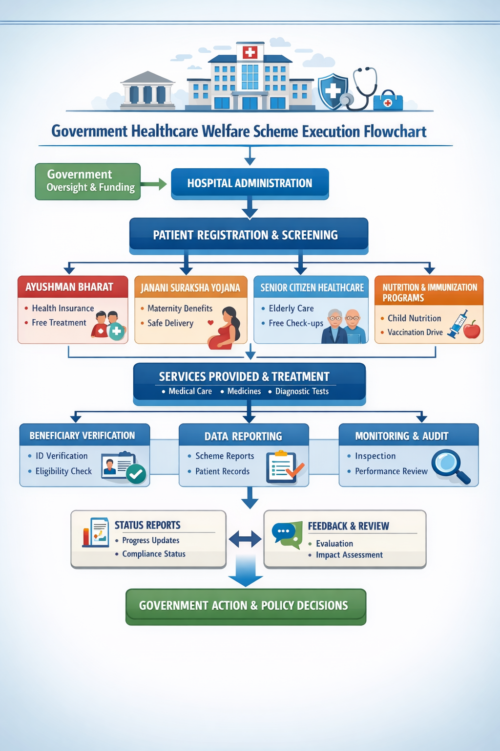
Client/Industry Relevance
Weight: 20%
Alignment with real-world client challenges and industry context
Value Delivered
For Policymakers
Clear visibility into what works and what doesn’t
Data-backed funding and policy decisions
Move from reporting to insight
For Health Departments
Better targeting of awareness campaigns
Enable outcome-driven healthcare governance
Optimized infrastructure and workforce planning
For Citizens
Improved access to affordable healthcare
Reduced delays and financial burden
Implementation Roadmap (High-Level)
Phase 1: Data integration & governance
Phase 2: Analytics & dashboards
Phase 3: Advanced insights & AI
Future Enhancements
AI-driven disease outbreak prediction
Personalized scheme recommendation for citizens
Mobile dashboards for district officers
Integration with wearable & preventive health data

Slide 5
Technology And Architecture
Weight: 20%
< Provide a diagrammatic view of the Architecture for the proposed solution calling out the key technology components >
Technology Flow Chart
Advance Analytics
Summary
Forecasting
Budgeting
Audit
Reconciliation
Oracle APEX
AI
Source System
ERP, AWS, Cloud
Source Data
Data Analytics
Dashboard
Analysed data

Slide 6
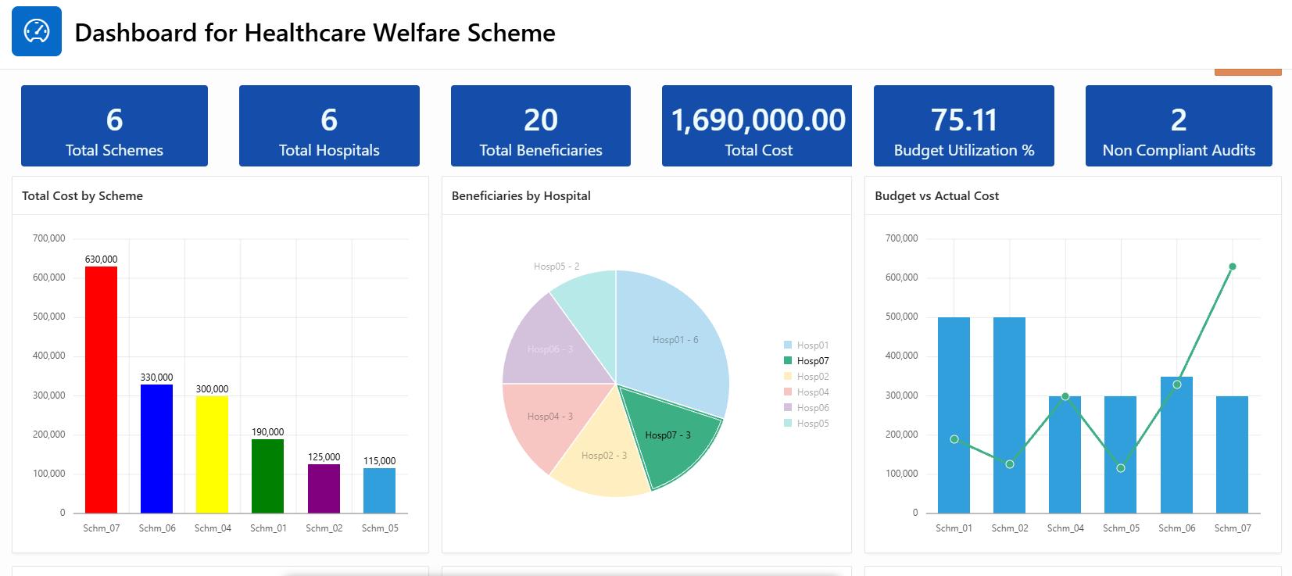
Technology And Architecture
Weight: 20%
< Provide a diagrammatic view of the Architecture for the proposed solution calling out the key technology components >

Slide 7
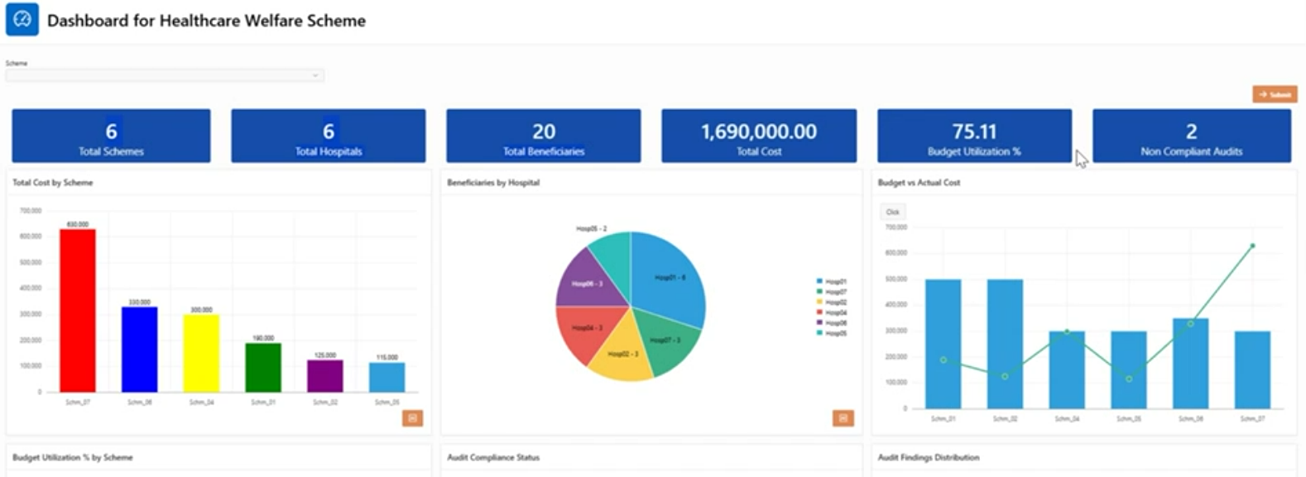
Technical Innovation
Use of GenAI/Agentic AI in a novel, effective, and technically sound way
< Highlight and differentiate why this solution is unique as compared to other solutions that already exist>

Slide 8
Working Prototype
Weight: 10%
Functionality, completeness, and clarity of the PoC/demo
< Upload files on GITHUB>

Slide 9
Responsible AI & Scalability
Weight: 10%
Consideration of ethics, governance, and potential for enterprise deployment
< Describe your Solution and highlight how Responsible AI Principles are applied in the Solution. Also Focus on Data Privacy/Security Aspects in the Solution>

Slide 11
DXC techno-thon’ 26 – evaluation criteria
Criteria | Description | Weight
Business Impact of the Solution | Clear articulation of how the solution improves revenue, cost, or efficiency | 20%
Business Potential | Leader’s assessment of the Business Potential of the solution | 20%
Client/Industry Relevance | Alignment with real-world client challenges and industry context | 20%
Technical Innovation | Use of GenAI/Agentic AI in a novel, effective, and technically sound way | 20%
Working Prototype | Functionality, completeness, and clarity of the PoC/demo | 10%
Responsible AI & Scalability | Consideration of ethics, governance, and potential for enterprise deployment | 10%
Notes:
On Video: Sudha

